Slide 1
Handmade orderbook
Basically no AI used in the core order book (with exceptions for benchmarking, unit tests, etc.)

Slide 2
Core design
Core order book in C++ for efficiency, can run upwards of 10M orders/sec (as only 100 price levels for our site).
Two trees: limit buys/sells, each balanced AVL trees (led to a 70x performance improvement), each node is a different price with a linked list as data.
Pointers kept for each order to allow for O(1) cancellation/order lookup for efficiency.
Custom data structures made by hand (mostly because interesting/fun)

Slide 3
Specific prediction mechanics
Each option is traded as either YES or NO.
The NO price is just 100-YES, so the market is actually just trading NOs.
All stored on the database using TigerData.

Slide 4
The Database

Slide 5
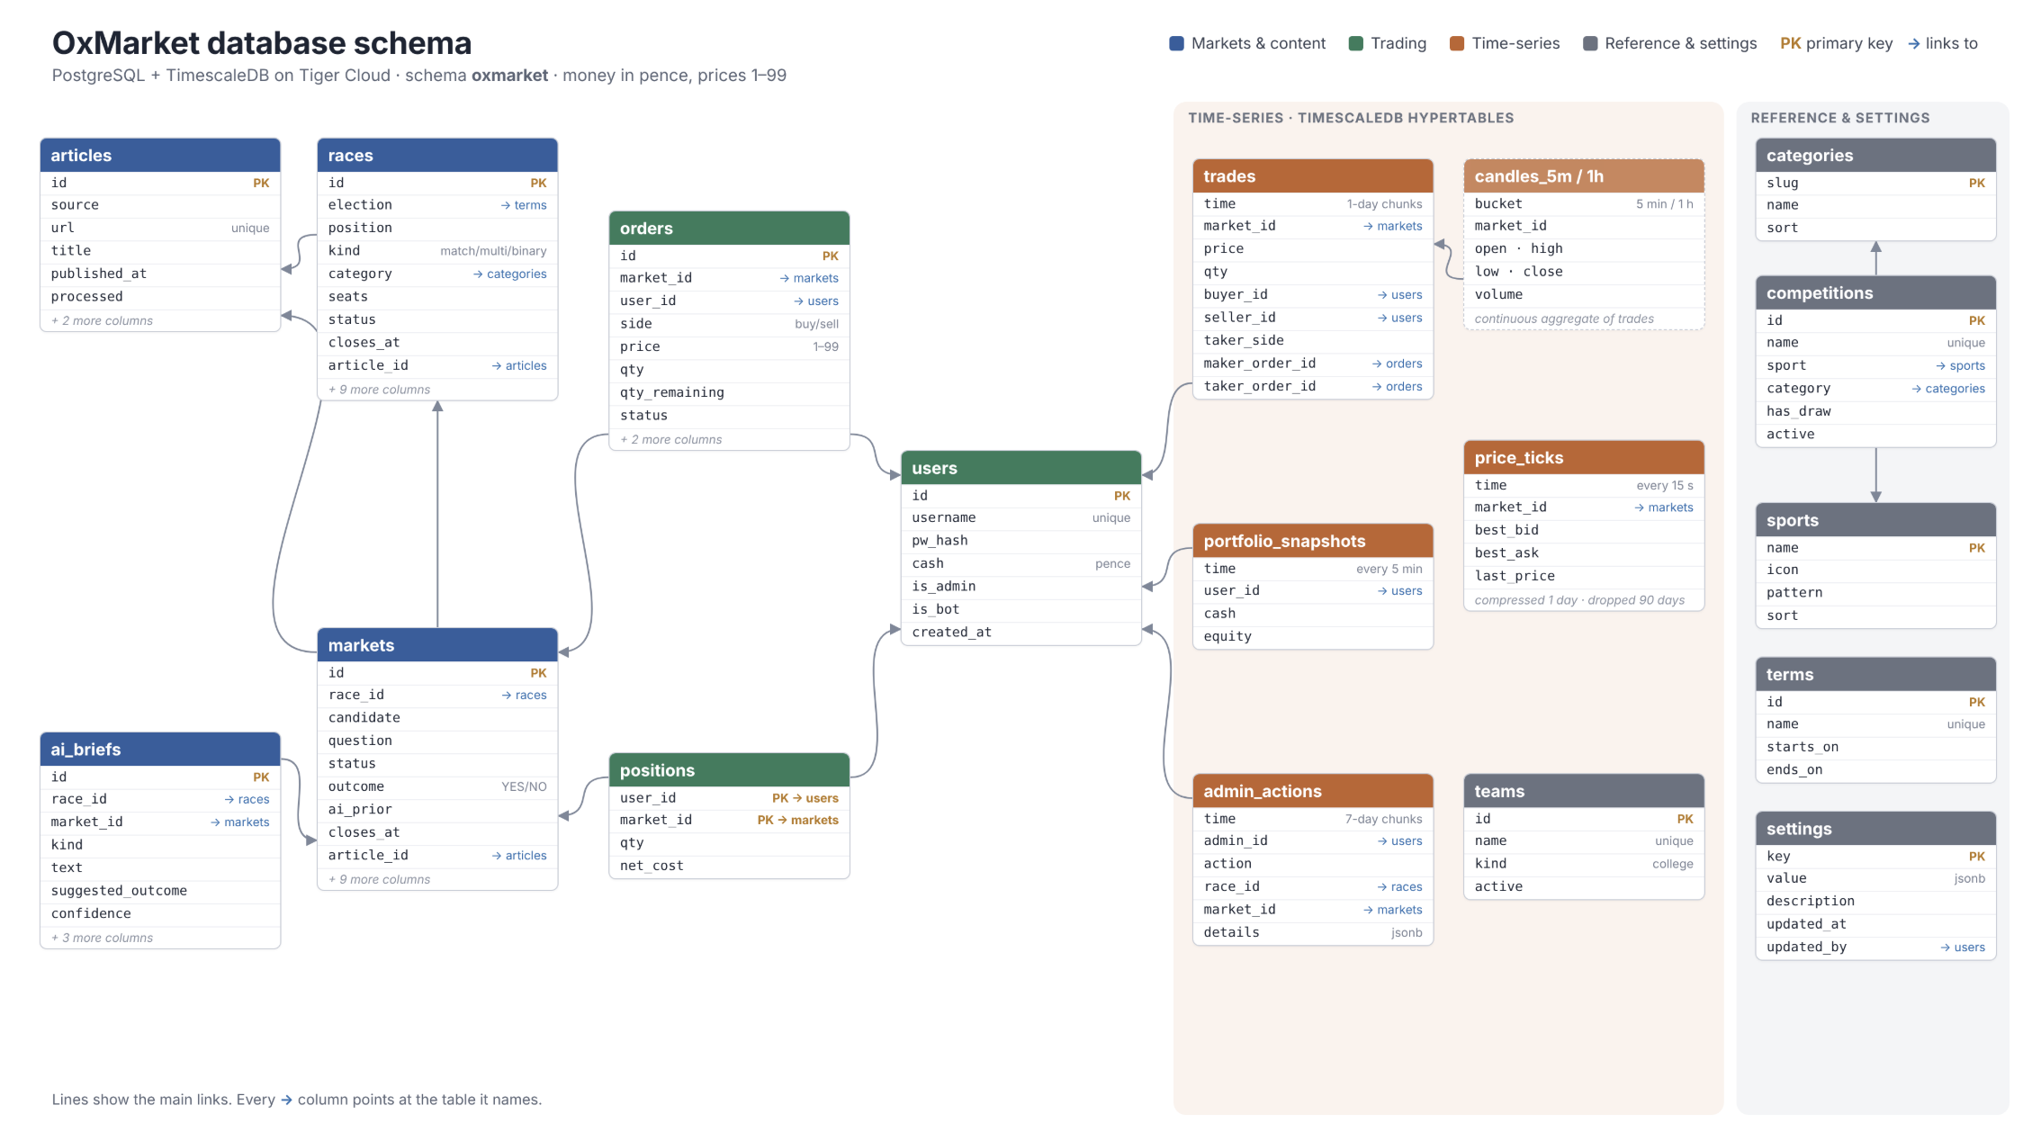
DB Schema

Slide 6
Predicting the Isis flag
Can tomorrow’s weather and the current flag tell us weather we can row tomorrow?

Slide 7
The data input
A reliable prediction for tomorrow’s weather at 07:00 on the Isis: Temperature, rain, wind speed & direction, gusts, visibility, CAPE, WMO weather code. This data comes from the met office/the local Isis weather station
Today’s OURC flag. This data comes from the official OURC website

Slide 8
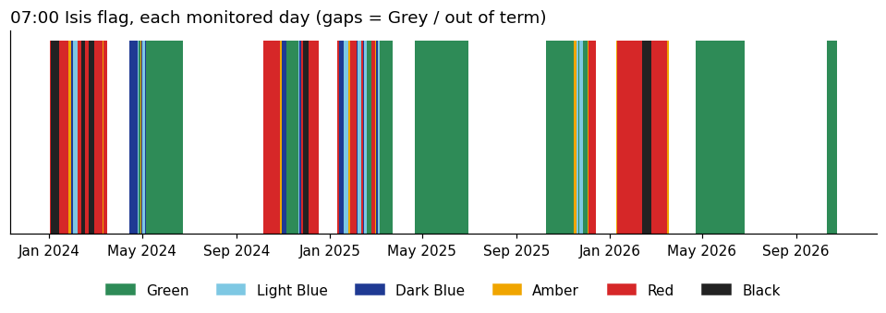

Slide 9
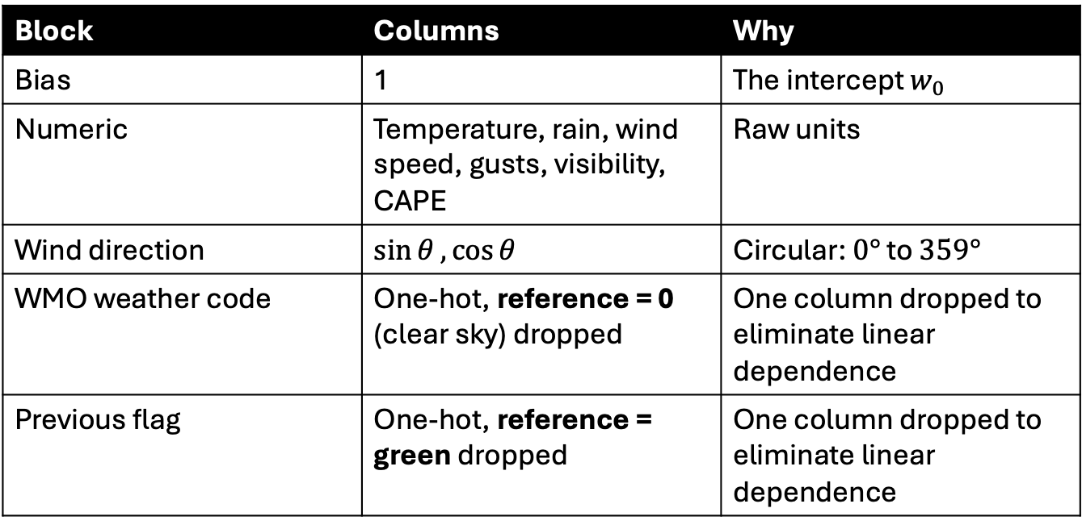
Building the design matrix X
features(row, code flags) turns one day into one row of X
Block | Columns | Why
Bias | 1 | The intercept $w_{0}$
Numeric | Temperature, rain, wind speed, gusts, visibility, CAPE | Raw units
Wind direction | $$\sin{θ}, \cos{θ}$$ | Circular: $0°$ to $359°$
WMO weather code | One-hot, reference = 0 (clear sky) dropped | One column dropped to eliminate linear dependence
Previous flag | One-hot, reference = green dropped | One column dropped to eliminate linear dependence

Slide 10
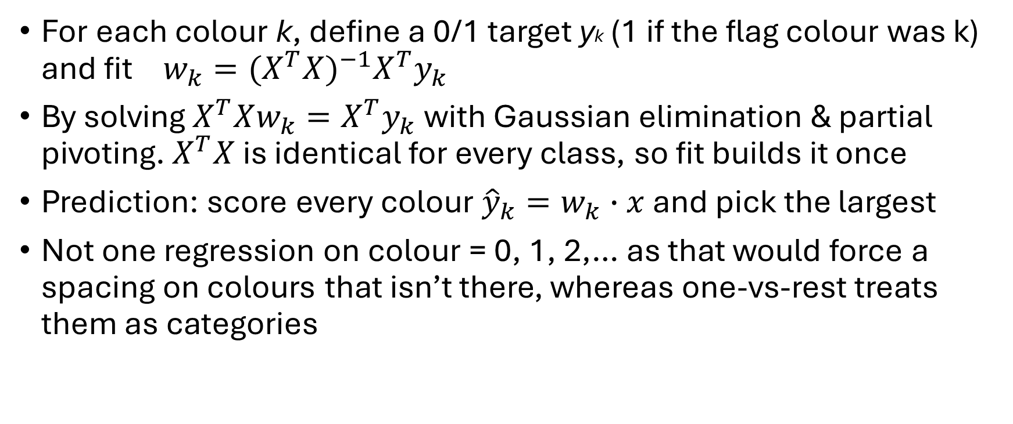
The method: least squares, one-vs-rest
For each colour k, define a 0/1 target yk (1 if the flag colour was k) and fit$w_{k}={(X^{T}X)}^{−1}X^{T}y_{k}$
By solving $X^{T}Xw_{k}=X^{T}y_{k}$ with Gaussian elimination & partial pivoting. $X^{T}X$ is identical for every class, so fit builds it once
Prediction: score every colour ${\hat{y}}_{k}=w_{k}∙x$ and pick the largest
Not one regression on colour = 0, 1, 2,… as that would force a spacing on colours that isn’t there, whereas one-vs-rest treats them as categories

Slide 11
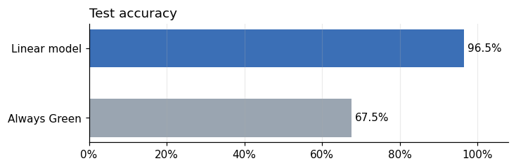

Slide 12
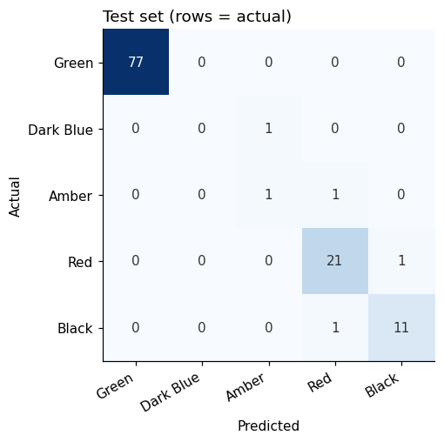

Slide 13
Summary
Model: one-vs-rest linear regression, solved exactly with the normal equations
Inputs: tomorrow’s weather and today’s flag
Result: ~96% test accuracy vs ~68% for “always green”

